Slide 1
Hackathon
THEME- OPEN INNOVATION
IN HEALTH CARE

Slide 2
Team name and member details
TEAM NAME – ABHIGYATAA
MEMBER 1 - Aanchal Singh Email-singhaanchal217@gmail.com
THEME- OPEN INNOVATION IN HEALTH CARE

Slide 3
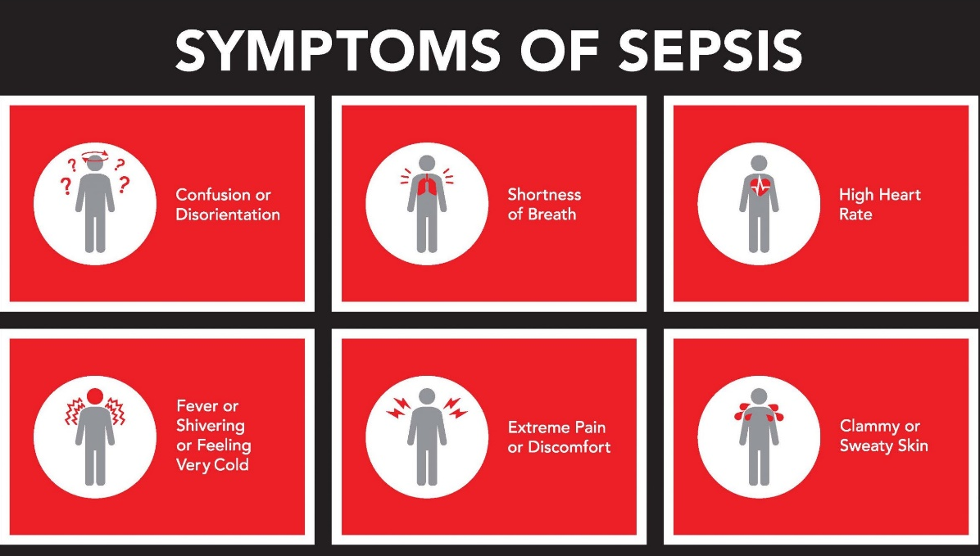
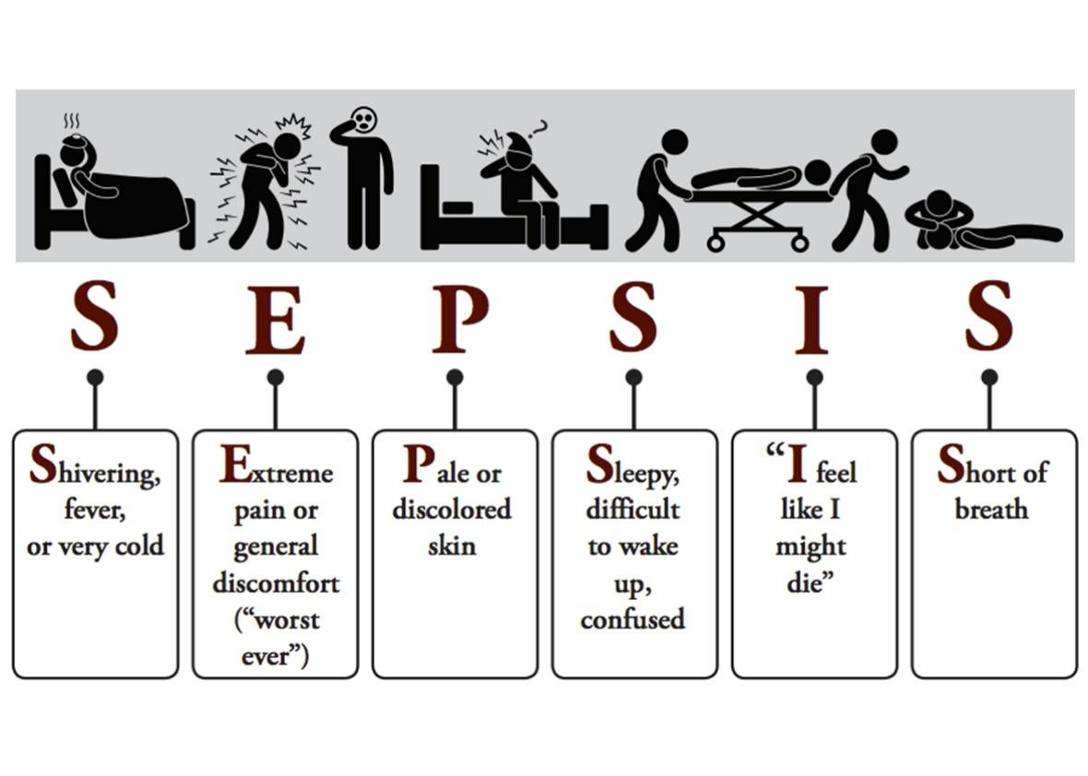
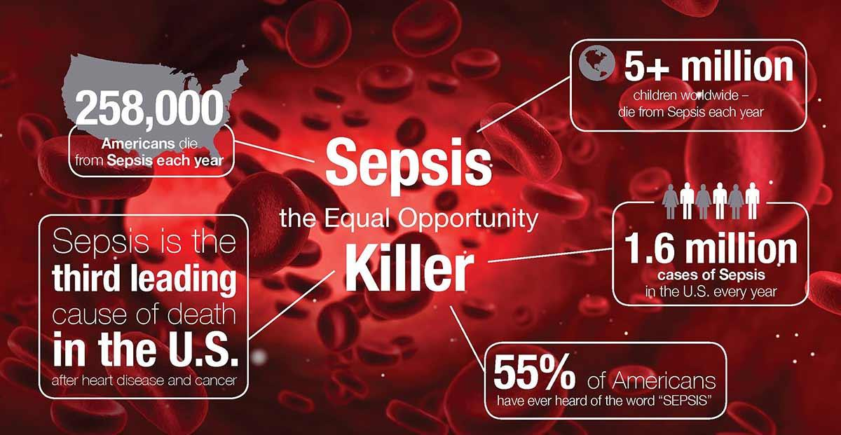
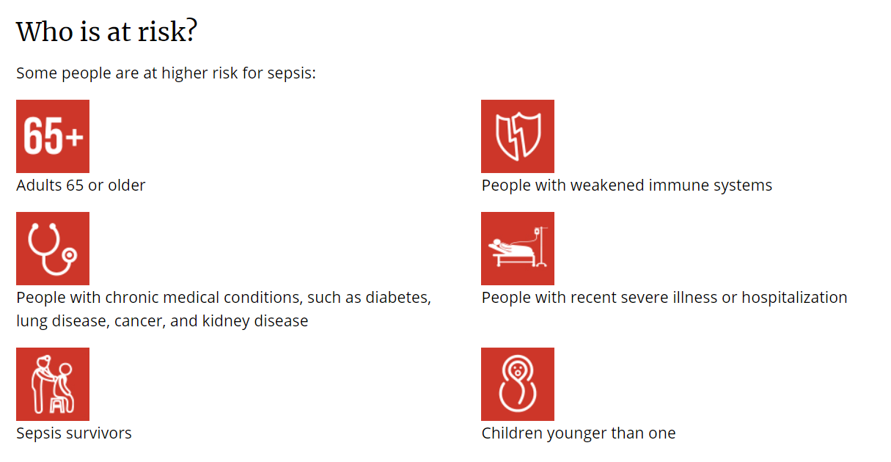
Problem statement
Anyone can get an infection, and almost any infection, including COVID-19, can lead to sepsis. In a typical year:
At least 1.7 million adults in America develop sepsis.
Nearly 270,000 Americans die as a result of sepsis.
1 in 3 patients who dies in a hospital has sepsis.
Sepsis, or the infection causing sepsis, starts outside of the hospital in nearly 87% of cases.
WHO GETS AFFECTED?
EARLY DETECTION and Spreading Awareness Regarding Sepsis and thereby preventing it.
WHAT IS SEPSIS? Sepsis is the body’s extreme response to an infection. It is a life-threatening medical emergency. Sepsis happens when an infection you already have triggers a chain reaction throughout your body. Infections that lead to sepsis most often start in the lung, urinary tract, skin, or gastrointestinal tract.

Slide 4
How is it affecting us?
According to WHO, it mainly impacts low and middle-income country thus is highly adverse for India.
Inimical to 30 million people world-wide, potentially leading to 6 million deaths.
It mainly affects people with weak immunity : elderly people, pregnant women, neonates, hospitalized patients and people with HIV/AIDS, liver cirrhosis, cancer, kidney disease and auto-immune diseases.
3 million newborns and 1.2 million children suffer from it.
Hospital costs of sepsis have doubled from 1997 to 2008 and is continuously increasing.
It covers approximately 40% of the ICU expenditure (USA hospital data).
Average cost per individual is nearly $ 22,000 thus a burden on the budget of households.
It is the pathway to death for 4 of the top 10 causes of death on our planet.

Slide 5
Solution
The main idea is “ early detection of sepsis using physiological data in real time using ML model “.
Develop a digital solution that uses artificial intelligence to detect patient deterioration before it’s too late and trigger notifications to clinicians and care teams.
Front-end interface developed as a website and telegram chatbot ,a tool for spreading awareness regarding sepsis.
Educate preventing infections in health care settings and in the community so that infections that can lead to sepsis can be stopped before they happen.
Provide guidelines to follow infection control requirements (e.g., Hand hygiene) and ensure one to receive recommended vaccines.
Trained machine learning model and integrated it with our website through a portal.

Slide 6
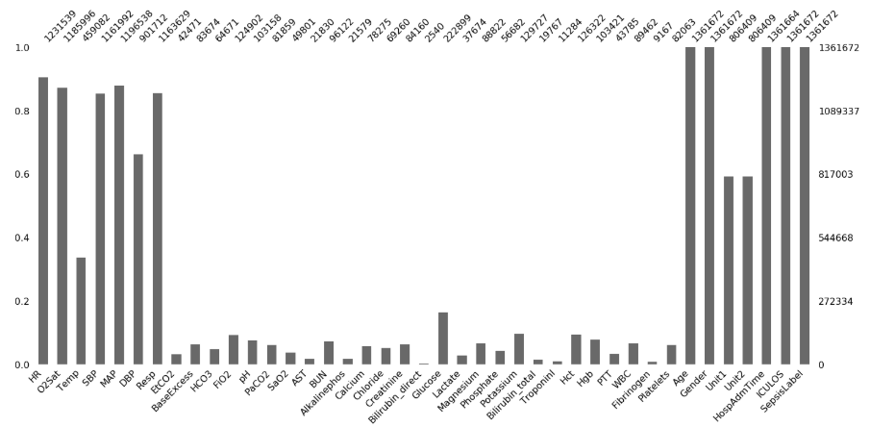
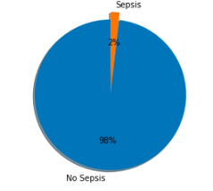
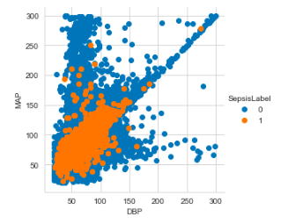
How Detection Model Works ?
Raw Data
Raw dataset collected from the physionet website.
42 physiological features have been selected initially.
The data has been combined in non-temporal way i.e. the hourly instance has been converted in independent and identical
Prediction now can be made with or without patient past data.
Combine Data
Many features have missing values in various instances
Imputation with mean values was excluded.
Features with more than 92% missing values were removed.
Others were encoded with a particular label.
Handling
Missing
Values
Feature Engineering
Correlation of features contributing to Sepsis was checked.
Major indicators foundain research journals were selected.
New features to generalize prediction were introduced.
Handling Missing Values
Data Imbalance
For imbalanced dataset, aspects such as over-sampling & under-sampling were considered to eliminate this problem.
Finally Decision-tree algorithm was used.
Processed Data and Baseline Prediction
Tested and trained model on 2 algorithms on the processed data obtained.
Working on 2 more training algorithm.
Correlation Diagram
Data Imbalance

Slide 7
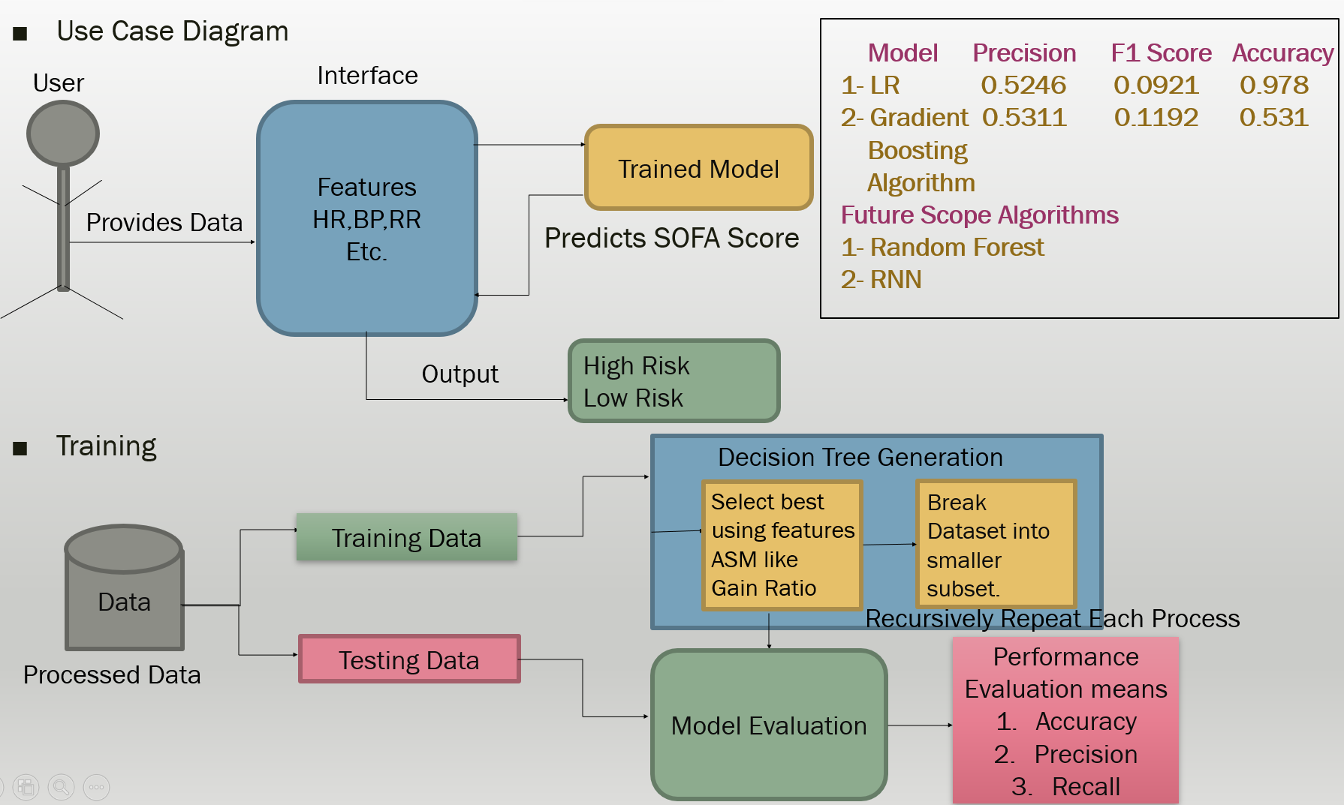
Methodology
We have divided the data set into two parts - Training set and Testing set.
70% of the data is used for training our ML Model. The training set is in-turn split so we can perform some validation before testing it on the test set. The rest 30% is used for testing the Model and calculating its accuracy and precision.
We have cleaned our data, and ran ML method for dealing with the imbalanced data, so our Model is trained properly.
Architecture
diagram

Slide 8
HOW DO WE SPREAD AWARENESS Regarding sepsis?
Awareness
Website
Telegram Bot
A Telegram chatbot will be included as a tool to spread awareness.
Real-time assistance along with better interaction will be provided once the chatbot gets trained enough.
More people can be handled as 24/7 service will be provided and only necessary queries will be forwarded to a real-person.
Covers all the aspects regarding prevention and symptoms.
ML prediction model is integrated with it that will do the task of early detection through SOFA score.
Training modules have been also included.
LINK TO OUR WEBSITE ABHIGYATA
Technology Stack: HTML5,CSS, Bootstrap 4, JavaScript, jQuery, Python in combination with Flask.
Technology Stack:-Python, PHP, Telegram API

Slide 9
Tech Stack
Website link- click here
Machine Learning Model:
Scikit Learn and xgboost.
Logistic Regression and Gradient Boosting Algorithm.
Jupyter Notebook.
MatPlot, Pandas, NumPy
Web Scraping
Website
HTML5,CSS, Bootstrap 4, JavaScript, jQuery.
Python in combination with Flask.
Telegram Chatbot
Python, PHP
Telegram API

Slide 10
Future Scope
We can increase the physiological dataset which is used for training and testing of ML model so that we can improve the accuracy and efficiency of our Model.
We also want to more hospitals and clinicians to connect with our website and telegram chatbot so that-
We can improve the user experience and provide better and immediate help to our users.
Provide better training to health workers and caretakers.
We can add the notification alerts in the telegram chatbot for hospitals so that hospitals can provide immediate help if the user using our bot need some urgent medical support.
Societal Impact / Novelty
We would be able to reduce this life-threatening medical emergency i.e sepsis, once this ML model and website is used by more no. of hospitals and clinics thereby helping to tackle this deadly condition.

Slide 11
Thank You

